Slide 1
What’s Cooking?
Team RockStars
Vidhi Shah
Pragya Gautam
Laura Ying Liu
Notes:
https://www.kaggle.com/c/whats-cooking-kernels-only

Slide 2
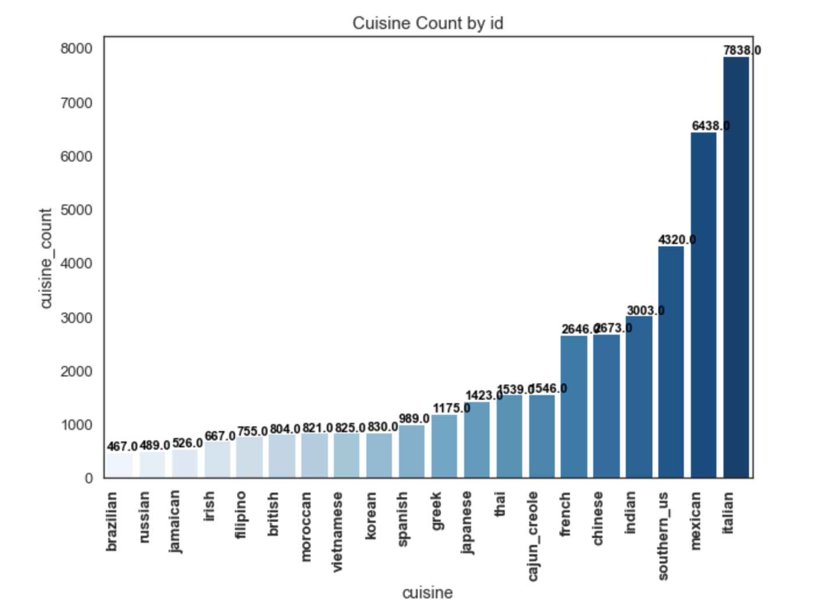
Introduction
The project predicts the category of a dish's cuisine given a list of its ingredients, such as garlic, tomato, onion. There are 20 different cuisines, and 6714 unique ingredients in the dataset.
For each cuisine we count the most frequent ingredients.
Except the frequent ingredients in specific cuisines, there are ingredients with high degree of uniqueness: soy sauce (asian cuisine), sake (Japanese), sesame oil (asian cuisine), feta cheese crumbs (Greek), garam masala (Indian), ground ginger (Moroccan), avocado (Mexican).
Common ingredients: salt, oil, peper, sugar. Most frequent ingredients are salty seasonings.
Difficulty: some ingredients have more than one name, such as garlic and garlic cloves.
Notes:
Italian: 7838 Mexican: 6438 Southern US: 4320 Indian: 3003 Chinese: 2673 Others: 15502.
Top 1 ('salt', 3454)
Top 2 ('olive oil', 3111)
Top 3 ('garlic cloves', 1619)
Top 4 ('grated parmesan cheese', 1580) Top 5 ('garlic', 1471)
Top 6 ('ground black pepper', 1444) Top 7 ('extra-virgin olive oil', 1362)
Top 8 ('onions', 1240)
Top 9 ('water', 1052)
Top 10 ('butter', 1030)

Slide 3
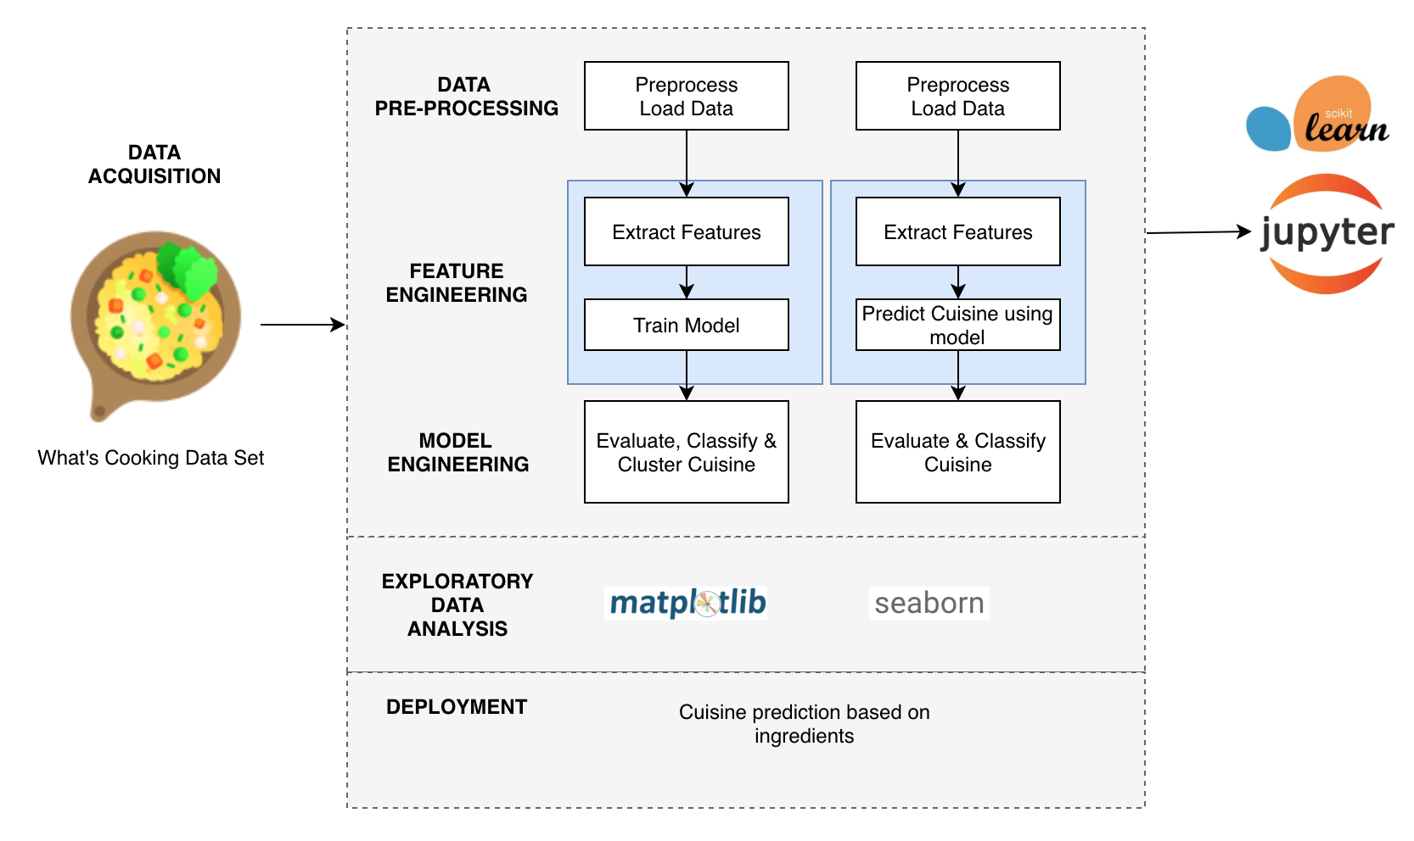
Architecture Diagram/KDD

Slide 4
Technology Utilized
Two clusterings: K-means clustering and Gaussian clustering with 3, 4 or 5 clusters.
4 Machine Learning models: linear SVC algorithm, logistic regression, decision tree and random forest
Data validation and testing: confusion matrix and classification report (precision, recall, f1-score, support for each type of cuisine)
Two preprocessing techniques: TF-IDF transformer and PCA
Two techniques for preparing data: Label Encoder, and Tf-Idf Vectorizer

Slide 5
Data Details
The data we are using is from the Kaggle “ What’s Cooking? ” competition. There are training set and testing set in the data and both in JSON format.
train.json – 39774 records containing recipe id, type of cuisine and list of ingredients
test.json – 9942 records containing recipe id and list of ingredients
one example of recipe record in train.json: {"id": 24717,"cuisine": "indian","ingredients": ["tumeric","vegetable stock","tomatoes","garam masala","naan","red lentils","red chili peppers","onions","spinach","sweet potatoes"]},

Slide 6
Training Details/Pre-processing
TF-IDF
PCA
Label Encoder
Notes:
TfidfVectorizer is Equivalent to CountVectorizer followed by TfidfTransformer. That is, you start with a corpus of raw texts. In order to get to a sparse matrix of TF/IDF values, you:
1.first need to tokenize, 2. then count tokens, 3. then transform the raw counts to TF/IDF Values.
TfIdfVectorizer does items 1–3. TfidfTransformer starts with counts, and does just item 3.
Label Encoder - assigns unique numerical value to each cuisine

Slide 7
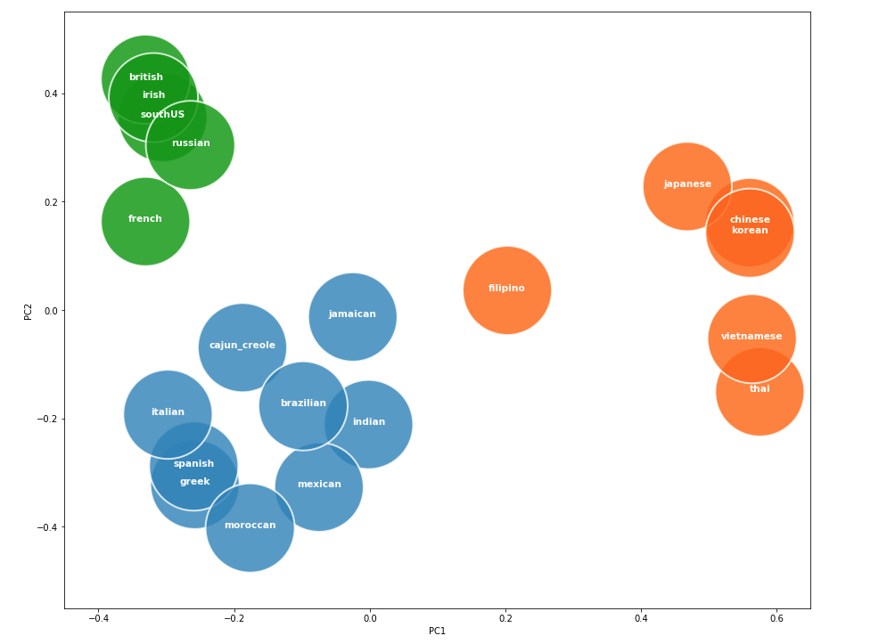
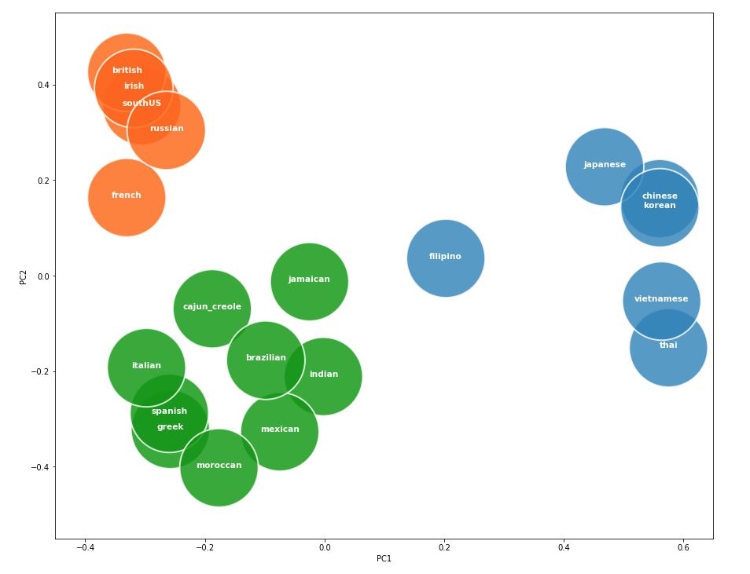
K Means vs Gaussian (3 clusters)
K-Means
Gaussian

Slide 8
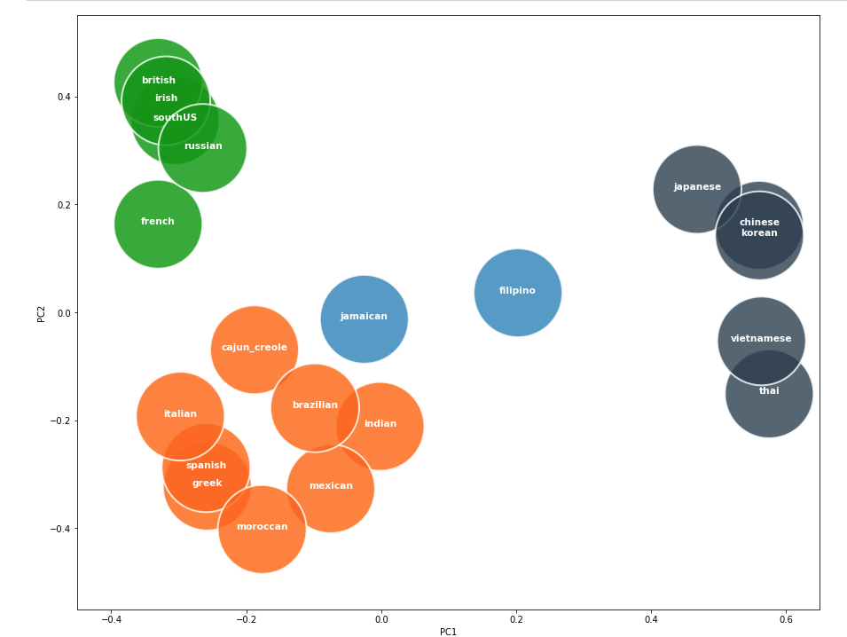
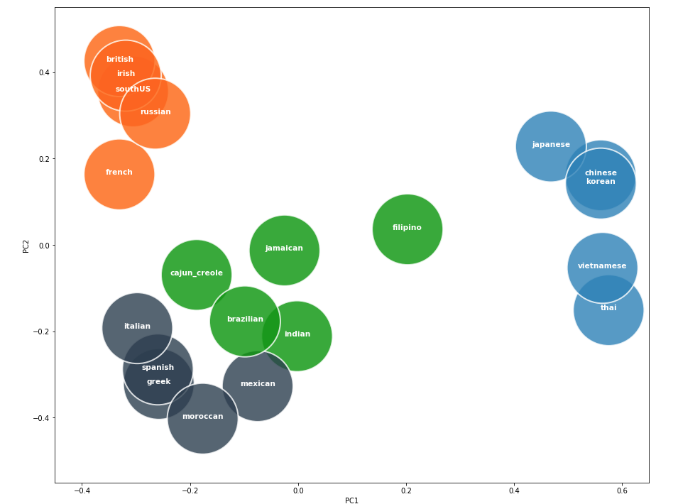
K Means vs Gaussian (4 clusters)
K-Means
Gaussian

Slide 9
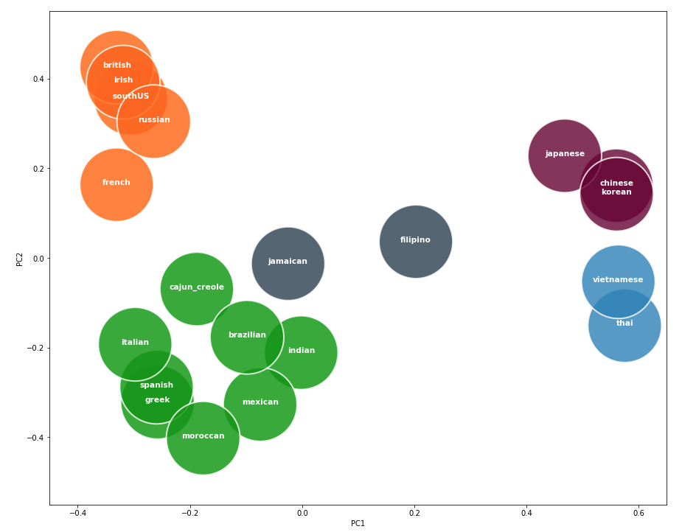
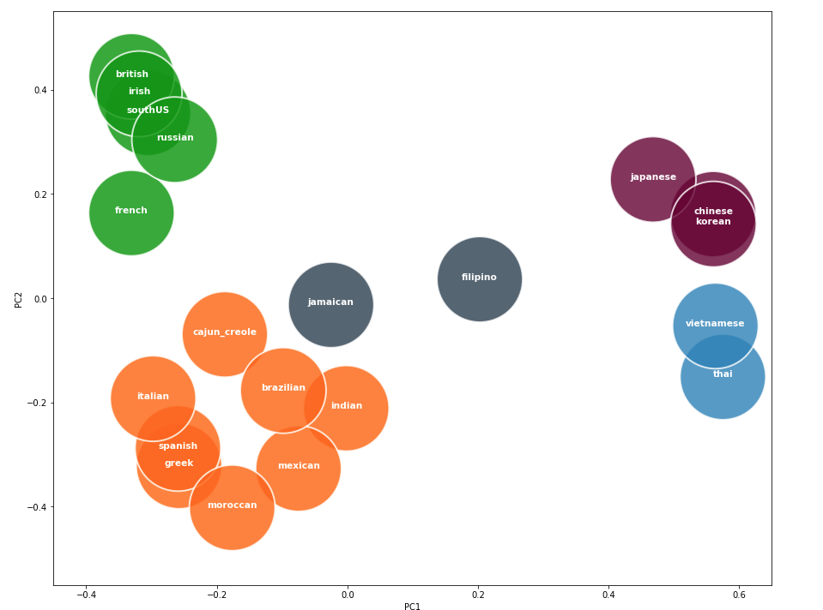
K Means vs Gaussian (5 clusters)
K-Means
Gaussian

Slide 10
Classification Models
Linear SVC
Similar to SVC with parameter kernel=’linear’, but implemented in terms of liblinear rather than libsvm
This class supports both dense and sparse input and the multiclass support is also handled
Logistic Regression
Multi-Class classification Handling
Decision Tree
Random Forest Classifier
A random forest is a meta estimator that fits a number of decision tree classifiers on various sub-samples of the dataset and uses averaging to improve the predictive accuracy and control over-fitting.

Slide 11
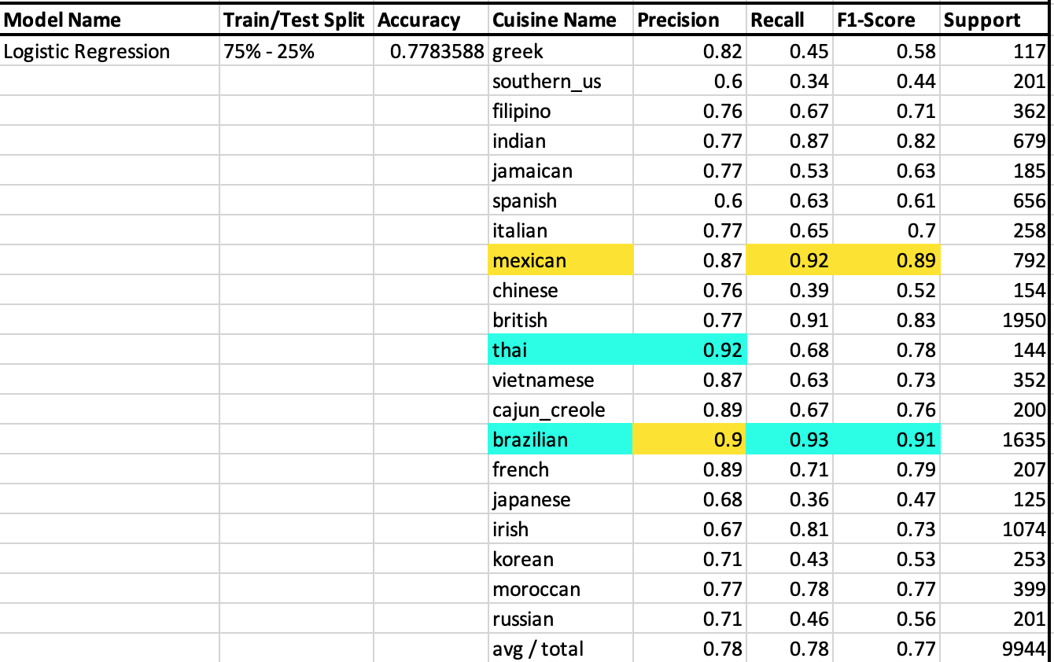
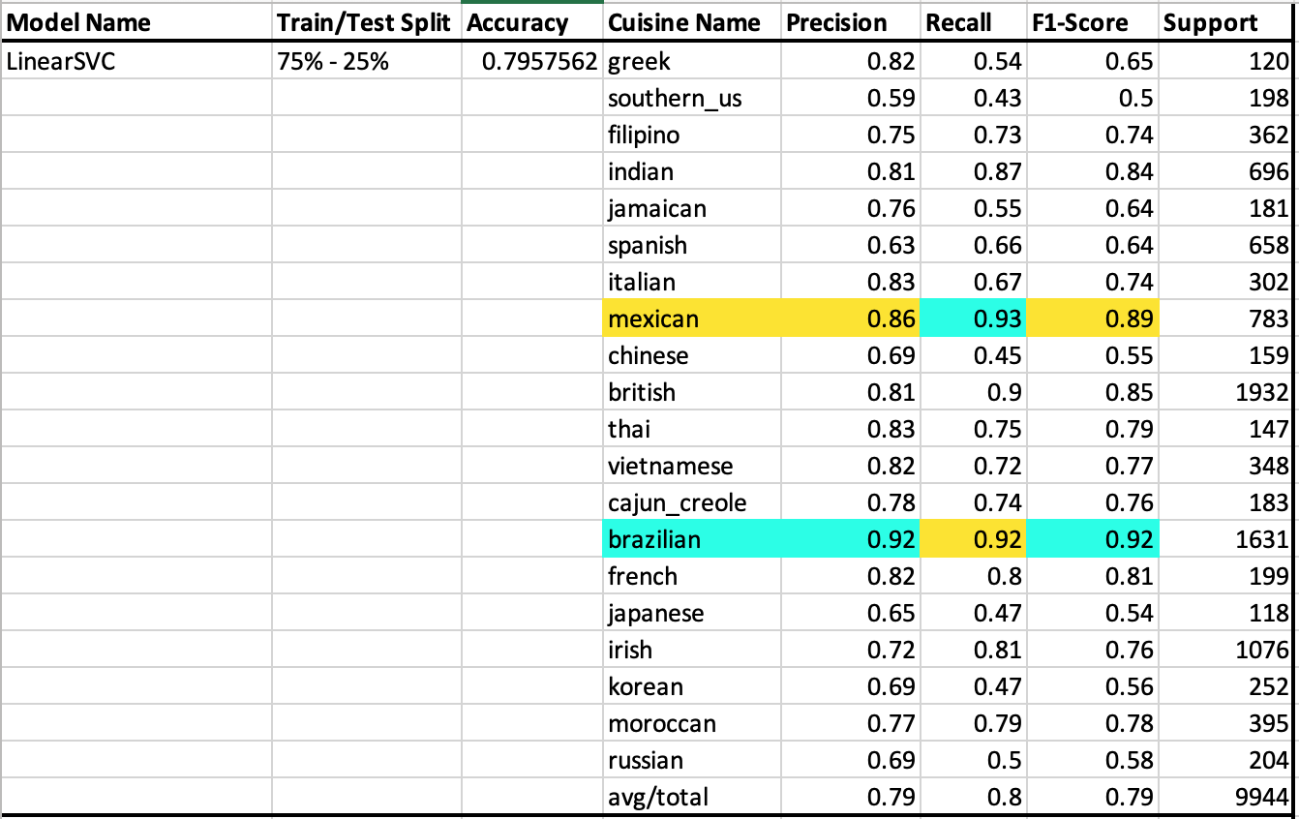
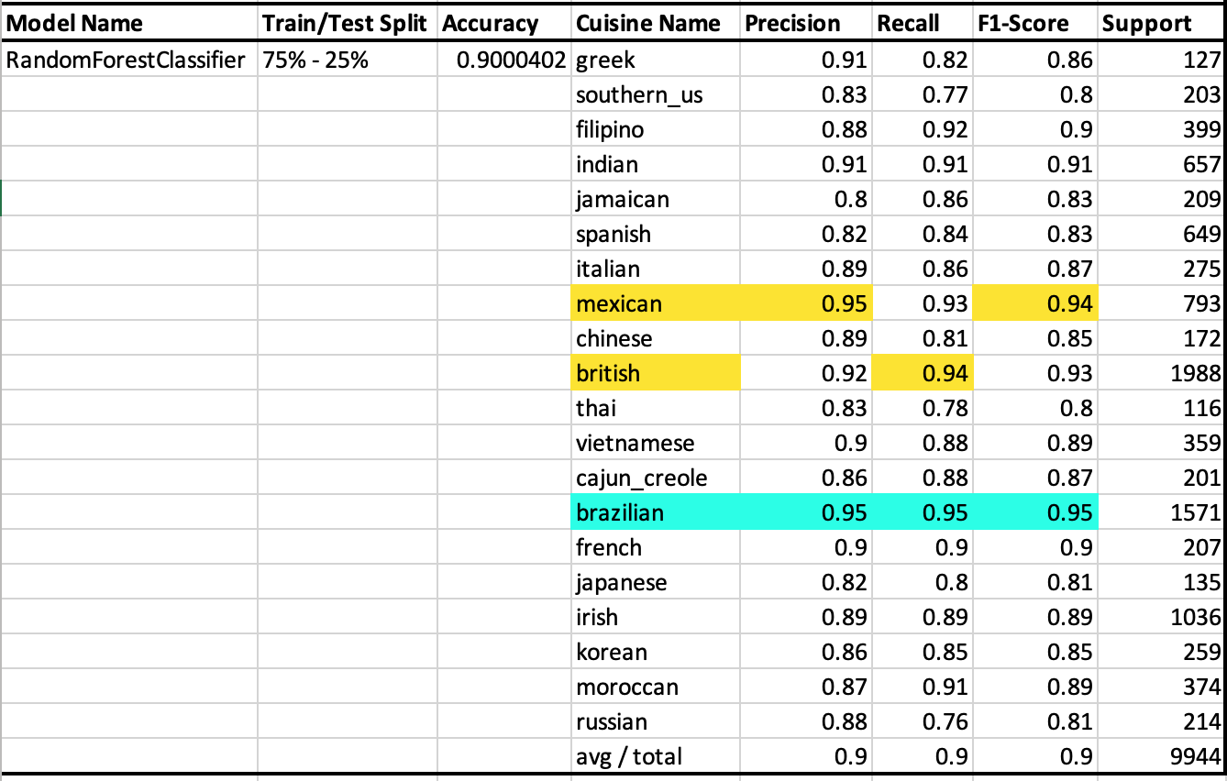
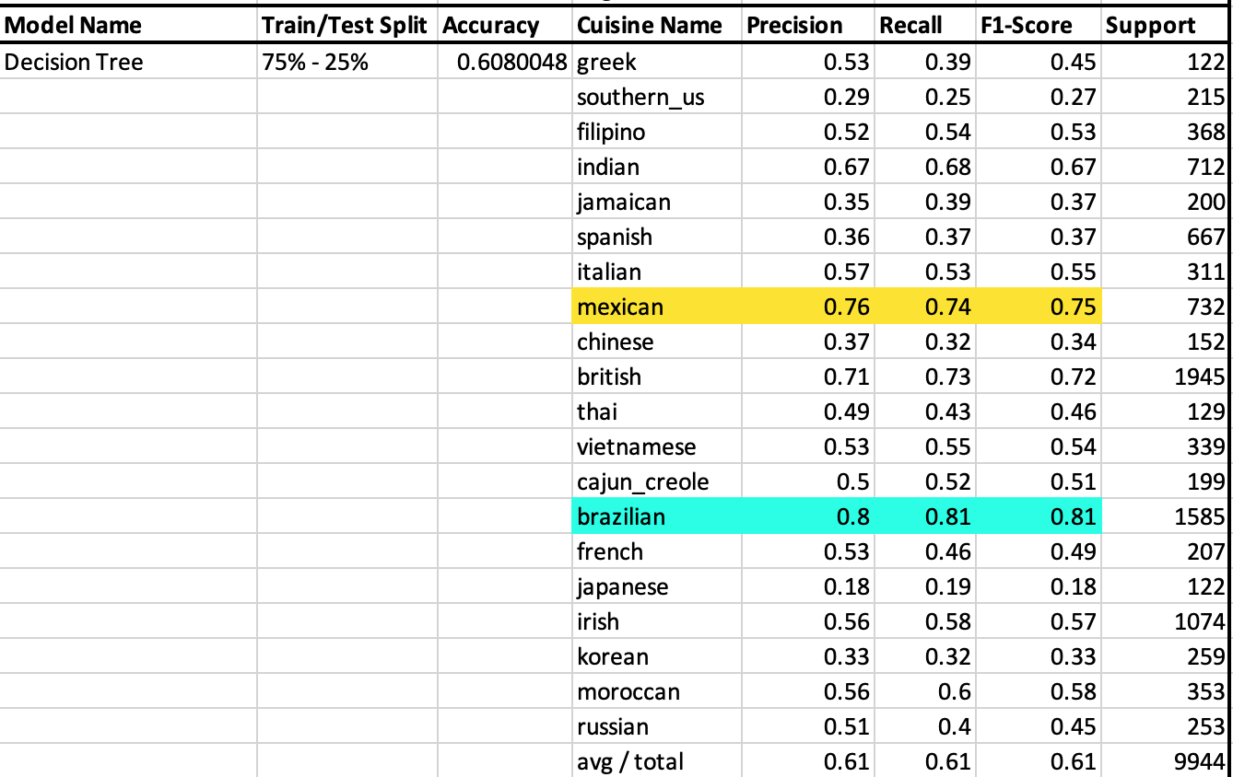
Inter-Model Comparison

Slide 12
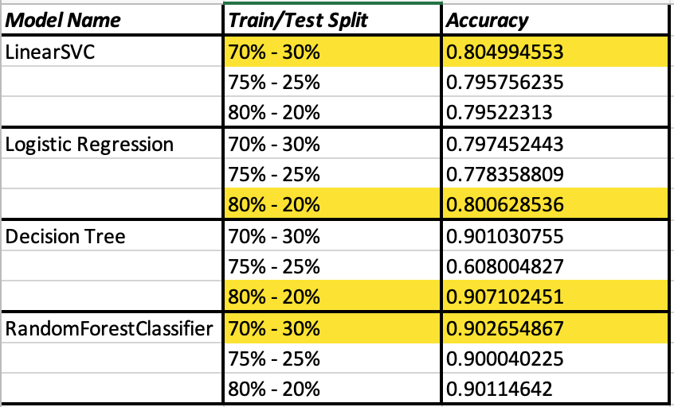
Intra-Model Comparison

Slide 13
DEMO

Slide 14
THANK YOU!

